Slide 1
SQL Programming
Joining Tables

Slide 2
Module 08: Joining Tables Page A-1: Intro
We just spent an entire semester manipulating and retrieving data from databases that were built around a single table.
You did good work. You learned a lot. And now you’re going to extend those skills to work in the realm of multiple-table databases.
By and large, multiple-table database are the reality of modern database systems. Single-table databases are extremely rare. And as I look back on my experience, I can’t think of any single-table database system that I’ve ever used, let alone designed.
If my needs were so ‘trivial’ as to use a single-table database, I’d probably build the application in a spreadsheet. ☺
So let’s get started.

Slide 3
Module 08: Joining Tables Page B-1 Multiple Tables
Why are multiple-table databases the norm?
On the face of it, a single table is ever so much easier to understand. Why would we want to build a complicated multiple-table database structure?
Here’s the short story.
Design Rule 1. Simple is better.
A single-table database devolves into a table that has everything, including the kitchen sink, thrown into it. When that happens we wind up with an unwieldy and complicated structure. Think of it as being “too much to deal with”.
A properly designed multiple-table database logically arranges the data elements into separate and distinct tables such that “there’s a place for everything and everything has its place”.

Slide 4
Module 08: Joining Tables Page B-2 Multiple Tables
In this regard, a multiple-table database system is inherently simpler and more effective than a single-table database system.
And, a ‘properly’ designed multiple-table database system is effective, efficient, robust, and guaranteed to be free of certain update anomalies.
Effective – in the sense of being easy to use, data is where it belongs and the users ‘know’ where to go for that data.
Efficient – in the sense of good performing. Like-related data elements are ‘close’ to one another, and generally, data doesn’t have to be gathered from ‘all over the place’ to satisfy an inquiry or an update..
Robust – in the sense of being adaptable to change. If new data requirements are identified the data model can be adapted to accommodate those needs.

Slide 5
Module 08: Joining Tables Page B-3 Insert Anomalies
A well designed multiple-table database system has been rigorously vetted through a process known as normalization.
This technique is beyond the scope of this course, but you should understand the problems that are averted with a normalized database model.
Consider the data in the table on the left as representing all of the information in our Academic Information System.
INSERT Anomaly occurs when we can’t add information to the database, because we don’t have some other bit of information. If we were to add a new major: Software Engineering SE, we couldn’t represent it in this model. We can’t add the new SE information until we have students in that major who have completed some course work.

Slide 6
Module 08: Joining Tables Page B-4 Delete Anomalies
DELETE Anomaly occurs when we can’t remove some information from the database, because we would lose some other bit of information.
When Joe graduates (or drops out) we can’t remove his record, because we’d lose all of the information in our system about CS majors. If Joe’s record goes, we’d never know we offered the CS Major.
UPDATE Anomaly occurs when we have to process the same change repeatedly throughout the system. The problem is that we might ‘miss one’.
For example, Mary the IDS major decides to change her name to Merry. We have to process that change in three different places in the database, with the prospect of missing an update, and introducing an error into the system.

Slide 7
Module 08: Joining Tables Page B-5 Averting Anomalies
This process of normalization generally refines a database design by adding/identifying new chunks of information that should stand on their own, in their own tables.

Slide 8

Module 08: Joining Tables Page C-1 Joining Tables
Assuming that you now understand, or at least appreciate, that there is some method to the madness of database design, your job as a SQL programmer often requires you to assemble these disparate tables into a single structure.
Huh?
If the most effective way to deal with the data is in multiple tables (ie. Normalized tables) why do we need to reassemble the data?
Think of it this way.
Your SQL program is a process that transforms data into information. The data structure is strewn across multiple tables. But what kind of structure is most effective for users in dealing with information? ….single table with all of the pertinent elements there in one place.

Slide 9
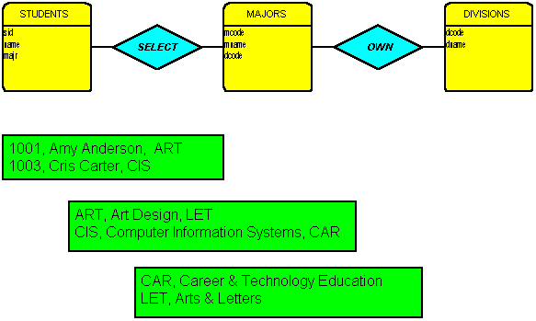
Module 08: Joining Tables Page C-2 Joining Tables
Let’s presume that this diagram depicts just one small aspect of the data model for our student record system.
The yellow boxes represent tables (entities) that contain information, the diamonds represent business relationships or associations that exist among the data.
In this example, we would say that STUDENTS SELECT MAJORS, and that MAJORS are OWNED by DIVISIONS.
The green boxes show sample data for each of the tables.
Amy is an ART major, or more specifically an ART DESIGN major. The ART DESIGN major is owned by (ie. part of) the ARTS and LETTERS Division on our campus.
Cris is a CIS major (Computer Information Systems) which is part of the Career Technology Education division on campus.

Slide 10
Module 08: Joining Tables Page C-3 Joining Tables
This normalized model has placed all of the student information in the STUDENT table.
All of the major information in the MAJORS table.
And all of the division information in the DIVISIONS table.
Problem:
Our user community would like a roster of all students, showing the student’s name, and the name of their major.

Slide 11
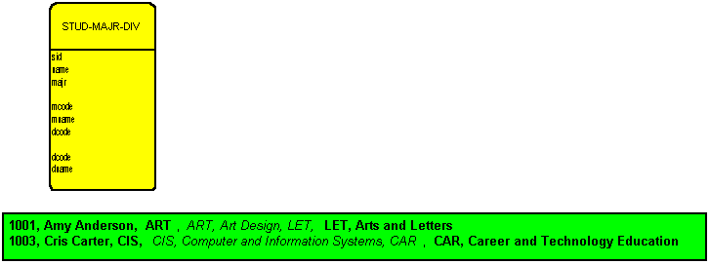
Module 08: Joining Tables Page C-3 Joining Tables
What we’d like to do is assemble these tables into one ‘logical’ table, and from that, select the columns and rows that our users need.
Select is the magic word here, so let’s revisit the SQL SELECT statement.

Slide 12
Module 08: Joining Tables Page C-4 Joining Tables
As you may recall, the syntax for the SELECT statement is something like this:
SELECT column-list
FROM table-list
[WHERE predicate expression]

Slide 13
Module 08: Joining Tables Page C-5 Joining Tables
We want to combine these
three base tables into the
following single result table.

Slide 14
Module 08: Joining Tables Page C-6 Joining Tables
SELECT column-list
FROM table-list
[WHERE predicate expression]
It seems to me that we’d like to be able to write something like this:
SELECT sid, name, majr,
mcode, mname, dcode,
dcode, dname
FROM students, majors, divisions
Notice that I’m using the FROM clause now to identify more than one table.

Slide 15
Module 08: Joining Tables Page C-7 Joining Tables
That’s my intention anyway.
But how do I insure that the rows in each table line up properly?
I mean, how do I insure that Amy’s row (in STUDENTS) lines up with the ART major row (in MAJORS) and all of that lines up with the ARTS and LETTERS row (in DIVISIONS)?

Slide 16
Module 08: Joining Tables Page C-8 Joining Tables
That magic will happen in the WHERE clause, but before we get there, we need to better understand what the FROM clause is doing.

Slide 17
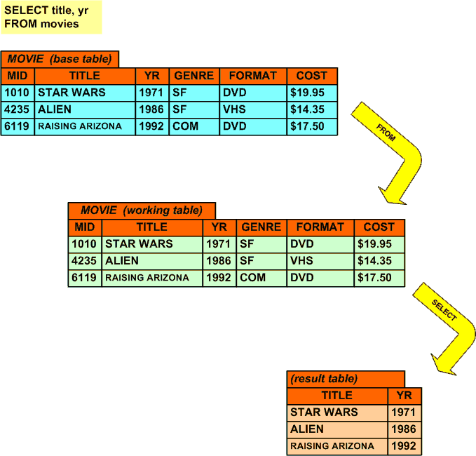
Module 08: Joining Tables Page D-1 SQL Processing Model
If you would, think back to the SQL processing model that I introduced in the Level 1 class.
That model works well, not only for single-table databases, but for multiple-table databases as well, and you’re about to see why.
The FROM clause is the first clause that is processed. And its purpose is to build the first working copy of the base tables.
This working copy will be the foundation for all subsequent working tables, up through the creation of the final result table.

Slide 18
Module 08: Joining Tables Page D-2 FROM Clause
When the FROM clause references only a single table, the extent of its processing is to merely copy that table into the first working table.
When the FROM clause references more than one table, the processing is slightly more involved. In these cases, the FROM clause creates something known as the Cartesian product of all of the tables that are listed.
The Cartesian product is a process that takes each row in one table and combines it with EACH row in another table.
Let me show you an example.

Slide 19
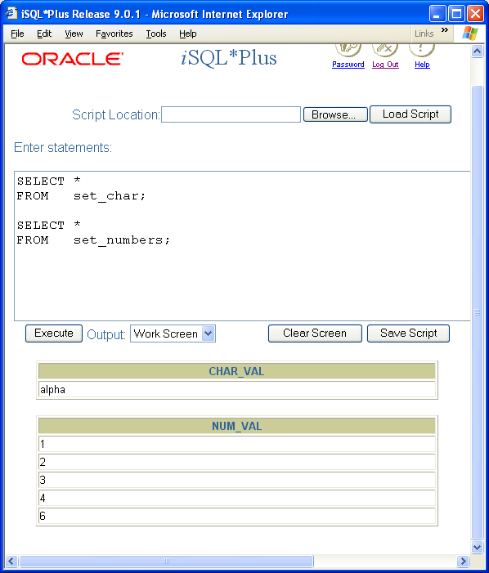
Module 08: Joining Tables Page D-3 Cartesian Product
I’ve created two simple tables. The first, set_char is just a collection of letters. The second, is a collection of numbers.
Each table has only a single column. In the set_char table that column is named: char_val (short for character value). In the set_numbers table, the column is named: num_val (short for number value).
The Cartesian product of these two tables would create a ‘super table’ that takes each row in the set_numbers table and adds that row to each row in the set_char table.
The result table should look something like this:
Alpha, 1
Alpha, 2
Alpha, 3
Alpha, 4
Alpha, 5

Slide 20
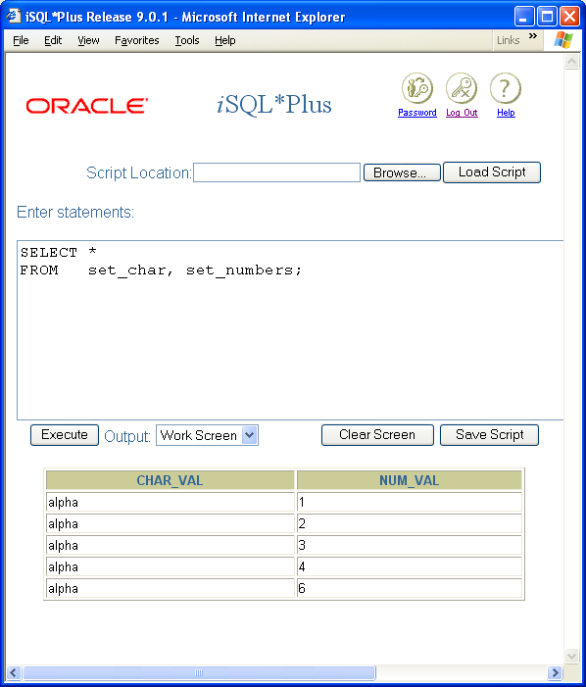
Module 08: Joining Tables Page D-4 Cartesian Product
Notice that the structure of the result table uses the same column names as the base tables, char_val and num_val.
Now I’m going to change the set_chars table, and add another row with the value ‘beta’.
What will the Cartesian product of set_char and set_numbers be after I add that row?

Slide 21
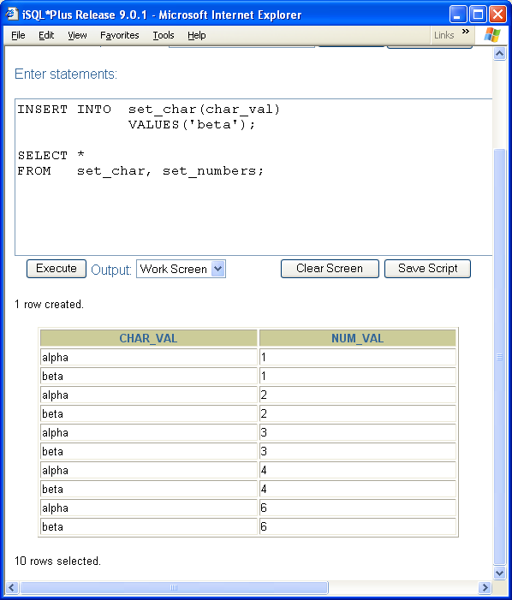
Module 08: Joining Tables Page D-4 Cartesian Product
The result table should look something like this:
Alpha, 1
Alpha, 2
Alpha, 3
Alpha, 4
Alpha, 5
Beta, 1
Beta, 2
Beta, 3
Beta, 4
Beta, 5
Each row in the set_numbers table is combined with each row in the set_char table.

Slide 22
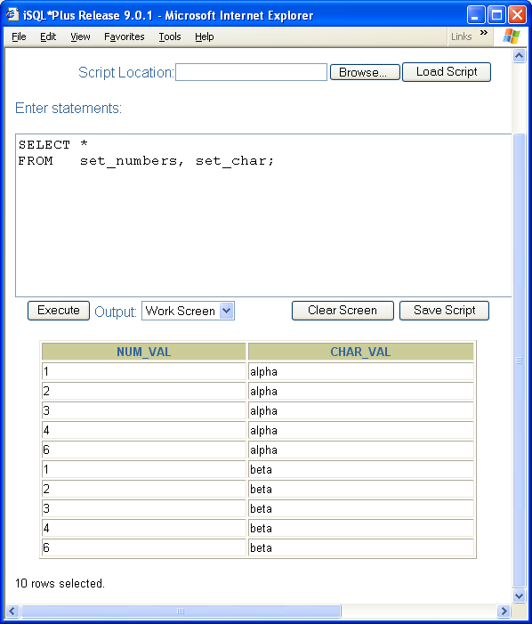
Module 08: Joining Tables Page D-5 Cartesian Product
It doesn’t matter how the tables are arranged in the FROM clause. The Cartesian product will always produce the same result table.
Note: these two tables are the same. The only difference is the order in which the rows and columns are presented, but the two result tables are the same, in the sense that they contain the same named columns, and the same rows of data.

Slide 23
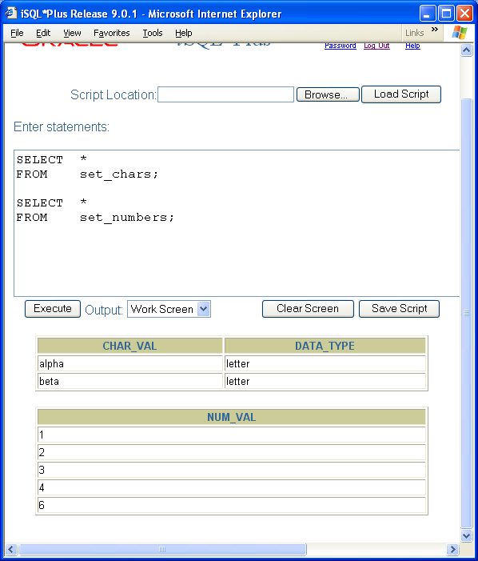
Module 08: Joining Tables Page D-6 Cartesian Product
In this example I’ve modified the set_chars table so that it now includes two columns.
What will the Cartesian product of these two tables look like now?

Slide 24
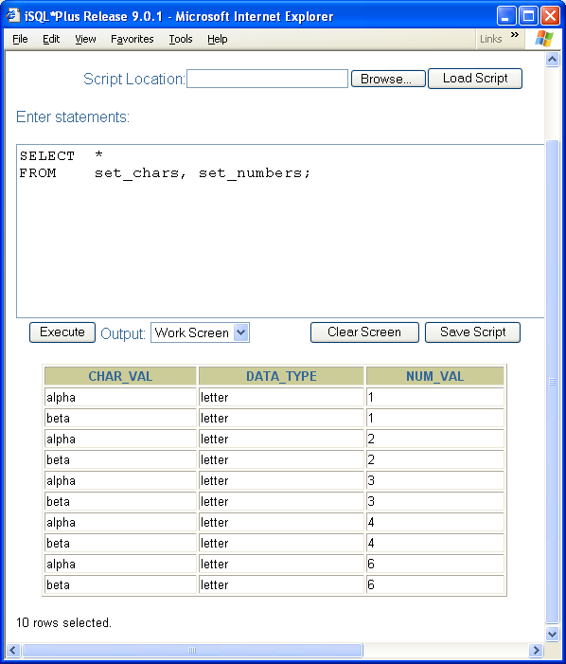
Module 08: Joining Tables Page D-6 Cartesian Product
Each of the rows in the set_numbers table combines with each of the rows in the set_chars table.
The structure of the result table is based on the underlying base tables.

Slide 25
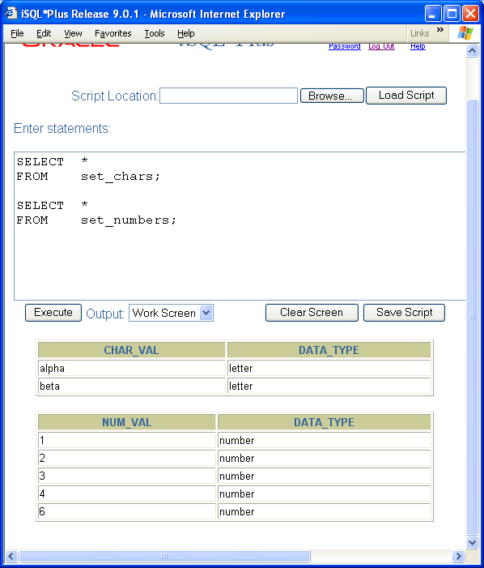
Module 08: Joining Tables Page D-7 Cartesian Product
Now each of the tables has been modified to contain two columns.
What will the Cartesian product of these two table be?

Slide 26
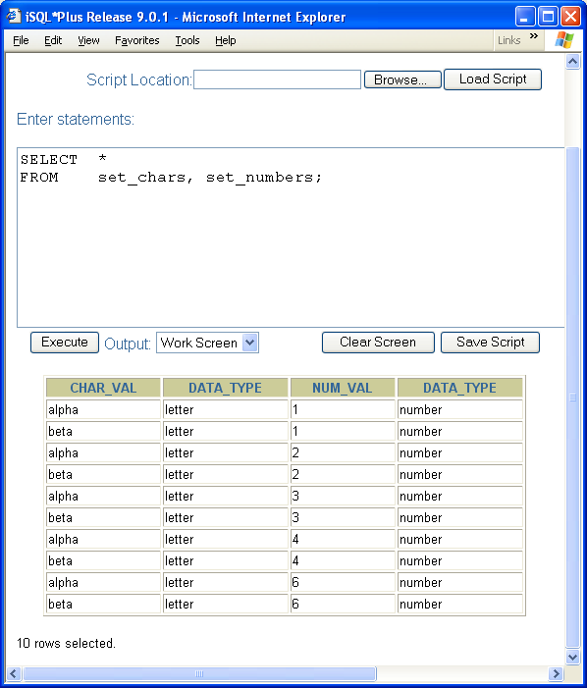
Module 08: Joining Tables Page D-8 Cartesian Product
Each of the rows in the set_numbers table combines with each of the rows in the set_chars table.
The structure of the result table is based on the underlying base tables. And since we have same-named columns in each of the base tables, we have two same-named columns in the result table (data_type).

Slide 27
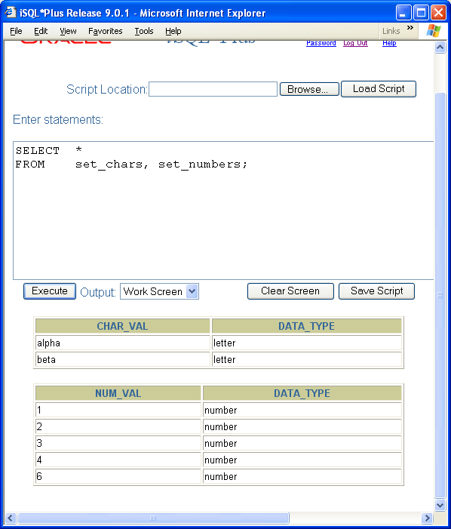
Module 08: Joining Tables Page D-9 Cartesian Product
How many rows will there be in the result table of the Cartesian product of two tables, one with 2 rows, the other with 5 rows?

Slide 28
Module 08: Joining Tables Page D-10 Cartesian Product
How many rows will there be in the result table of the Cartesian product of two tables, one with 2 rows, the other with 5 rows?
10 rows (2 * 5)

Slide 29
Module 08: Joining Tables Page D-11 Cartesian Product
How many rows will there be in the result table of the Cartesian product of two tables, one with 6 rows, the other with 4 rows?

Slide 30
Module 08: Joining Tables Page D-12 Cartesian Product
How many rows will there be in the result table of the Cartesian product of two tables, one with 6 rows, the other with 4 rows?
24 rows (6 * 4)
How about for two tables, one with 12 rows and the other with 5 rows?

Slide 31
Module 08: Joining Tables Page D-13 Cartesian Product
How many rows will there be in the result table of the Cartesian product of two tables, one with 6 rows, the other with 4 rows?
24 rows (6 * 4)
How about for two tables, one with 12 rows and the other with 5 rows?
60 rows (12 * 5)
How about for two tables, one with 10,000 rows (maybe a table of student enrolled this term at the college) and another table with 100 rows (perhaps a major code table with the names of each of the 100 programs of study available at the college)?

Slide 32
Module 08: Joining Tables Page D-14 Cartesian Product
How many rows will there be in the result table of the Cartesian product of two tables, one with 6 rows, the other with 4 rows?
24 rows (6 * 4)
How about for two tables, one with 12 rows and the other with 5 rows?
60 rows (12 * 5)
How about for two tables, one with 10,000 rows (maybe a table of student enrolled this term at the college) and another table with 100 rows (perhaps a major code table with the names of each of the 100 programs of study available at the college)?
1,000,000 rows (10,000 * 100)

Slide 33
Module 08: Joining Tables Page D-15 Cartesian Product
When Cartesian products are indicated in a SQL statement, even small base tables can generate very large result tables.
The resultant processing may adversely impact the performance of your system.
And be aware of this. My examples only highlighted two-table Cartesian products. Cartesian products can involve 3 tables, or 4 tables, or even more!

Slide 34
Module 08: Joining Tables Page D-16 Cartesian Product - Summary
The number of rows in the result table of a Cartesian product is the product of the number of rows in each of the base tables.
The number of columns in the result table of a Cartesian product is the sum of the number of columns in each of the base tables.

Slide 35
Module 08: Joining Tables Page E-1 WHERE Clause
Now let’s return to the problem that was posed earlier.
Our user community would like a roster of all students, showing the student’s name, and the name of their major.

Slide 36
Module 08: Joining Tables Page E-2 WHERE Clause
We want to combine these
three base tables into the
following single result table.

Slide 37
Module 08: Joining Tables Page E-3 WHERE Clause
This SELECT statement generates a Cartesian product (also known as the cross product) of the three tables that are listed in the FROM clause.
SELECT sid, name, majr,
mcode, mname, dcode,
dcode, dname
FROM students, majors, divisions
Quick review:
How many rows and columns will there be in the result table?
The number of rows in the result table of a Cartesian product is the product of the number of rows in each of the base tables.
Rows = 2 * 2 * 2 = 8
The number of columns in the result table of a Cartesian product is the sum of the number of columns in each of the base tables.
Columns = 3 + 3 + 2 = 8

Slide 38
Module 08: Joining Tables Page E-4 WHERE Clause
In our result table we don’t want every possible combination of rows.
We only want the rows that include the appropriately linked columns of information.
We only want the rows from the cross product where the MAJR column from the STUDENTS table, has the same value as the MCODE column in the MAJORS table.
And we only want the rows where the DCODE column in the MAJORS table has the same value has the DCODE column in the DIVISIONS table.

Slide 39
Module 08: Joining Tables Page E-5 WHERE Clause
Something like this:
SELECT sid, name, majr,
mcode, mname, dcode,
dcode, dname
FROM students, majors, divisions
WHERE majr = mcode AND dcode = dcode
Now there’s a a slight problem with this solution, but conceptually it’s exactly what we want to do, it’s exactly the way we want to format our WHERE clause and predicate expression.
Can you see how this code will produce the following result table?

Slide 40
Module 08: Joining Tables Page E-6 WHERE Clause
Let’s quickly review the SQL processing model.
Step 1: the FROM clause generates the first working table based on the tables listed in that clause. If more than one table is listed, we’ll be getting a cross product as our first working table.
Step 2: the WHERE clause kicks in and it specifies which rows from this first working table are to be kept, and carried forward for additional processing.
Step 1 joins the tables.
Step 2 finishes the work of the join, and hangs on to only the appropriately linked rows.

Slide 41
Module 08: Joining Tables Page E-7 WHERE Clause
In my opinion this is the most critical feature to understand about joining table.
If you don’t get it, please post a question to the discussion forum.
------------
Here’s a tricky question.
How many rows will there be in the result table after the join conditions in the WHERE clause are processed?
As many as the cross product generated
b. As many as the smallest table
c. No more than the largest table
d. The sum of the rows in each of the tables

Slide 42
Module 08: Joining Tables Page E-8 WHERE Clause
How many rows will there be in the result table after the join conditions in the WHERE clause are processed?
As many as the cross product generated
b. As many as the smallest table
c. No more than the largest table
d. The sum of the rows in each of the tables
The answer is:
c. No more than the largest table
For the discussion on this solution, please participate in the discussion forum.

Slide 43
Module 08: Joining Tables Page F-1 Ambiguities
When I presented this solution I suggested that there was something not quite right about it.
SELECT sid, name, majr,
mcode, mname, dcode,
dcode, dname
FROM students, majors, divisions
WHERE majr = mcode AND dcode = dcode
Did you notice anything untoward about this solution?

Slide 44
Module 08: Joining Tables Page F-2 Ambiguities
When I presented this solution I suggested that there was something not quite right about it.
SELECT sid, name, majr,
mcode, mname, dcode,
dcode, dname
FROM students, majors, divisions
WHERE majr = mcode AND dcode = dcode
Did you notice anything untoward about this solution?
Check out the SELECT and WHERE clauses. We have an ambiguously defined column lurking in there. dcode.

Slide 45
Module 08: Joining Tables Page F-3 Ambiguities
Dcode exists in two of our table: MAJORS and DIVISIONS. How can SQL tell which dcode to use in the SELECT Statement?

Slide 46
Module 08: Joining Tables Page F-4 Ambiguities
Dcode exists in two of our table: MAJORS and DIVISIONS. How can SQL tell which dcode to use in the SELECT Statement?
It can’t. At least not without our help.
We need to explicitly tell it where to draw the dcode information from.

Slide 47
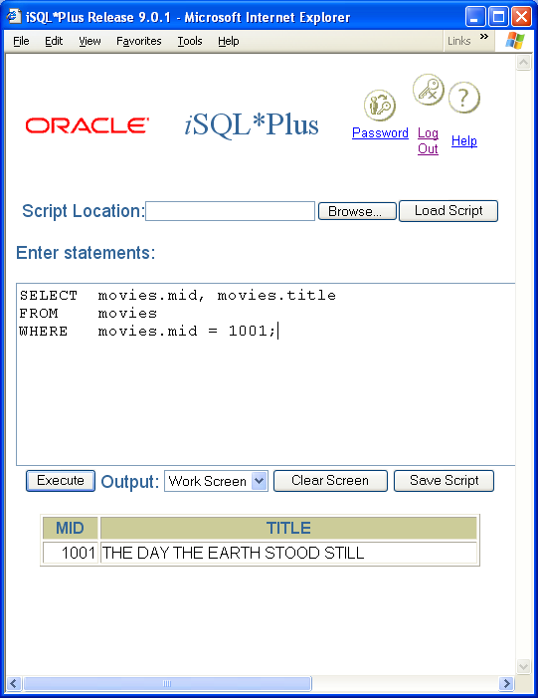
Module 08: Joining Tables Page F-5 Ambiguities
SELECT sid, name, majr,
mcode, mname, dcode,
dcode, dname
FROM students, majors, divisions
WHERE majr = mcode AND dcode = dcode
To disambiguate the code in this example we must explicitly state from which table each column is drawn from.
SELECT students.sid, students.name,
students.majr,
majors.mcode, majors.mname,
majors.dcode,
divisions.dcode, divisions.dname
FROM students, majors, divisions
WHERE students.majr = majors.mcode
AND majors.dcode = divisions.dcode

Slide 48

Module 08: Joining Tables Page F-6 Table Aliases
We learned early on that we could provide an alias for a column name. We are also able to apply aliases to tables.
But there is no keyword, such as AS, to indicate this assignment.
Simply assign the alias immediately after the table name, and before the comma.
For example:
SELECT s.sid, s.name, s.majr,
m.mcode, m.mname, m.dcode
d.dcode, d.dname
FROM students s, majors m, divisions d

Slide 49
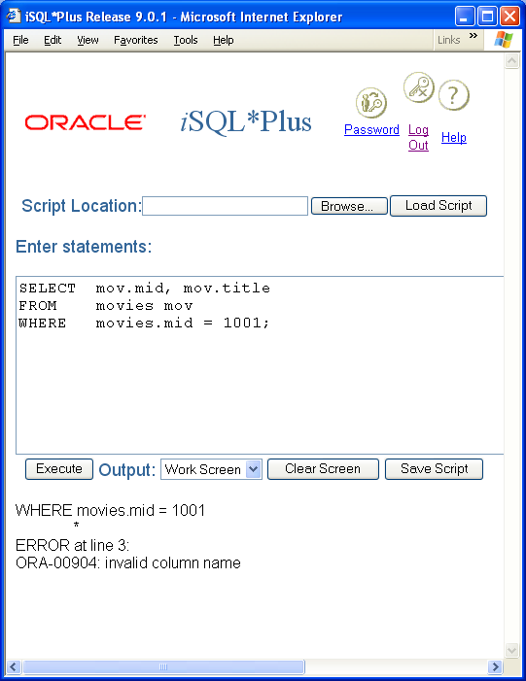
Module 08: Joining Tables Page F-7 Table Aliases
When table aliases are assigned in this fashion, the table alias must be used whenever you reference a column in that table.
You cannot use the table name to reference a column once that table has been assigned an alias.

Slide 50
Module 08: Joining Tables Page F-8 Table Aliases - Convention
Many of the examples in the book use a single character for the table alias.
I think this coding convention is a bad idea.
One of the most important aspects of our job as a professional programmer is to be sure that we document our work, and to write our code so that it is easily understood by the next person who has to work on it.
Which letter do you pick for the table alias? The first letter of the table name? What happens if two of the tables start with the same letter?
My preference when designing database systems is to define a set of standards for the application. One of the standards would be to define, for each table, a unique 3- or 4-character alias. Whenever a table alias is needed in an application, the programmer must (according to our standards) use the predefined abbreviation (alias).

Slide 51
Module 08: Joining Tables Page G-1: Summary
We’ve covered a lot of ground in this lesson, and there’s still a lot more to be said about joining tables.
But you need to take a break, and digest this material. Then carry on with the next module.

Slide 52
Module 08: Joining Tables Page T-1: Terminology
Single-table database
Multiple-table database
Normalization
Insert anomaly
update anomaly
delete anomaly
SQL Processing Model
FROM clause
Cartesian product, cross product
Qualified column names
Table aliases

Slide 53
Module 08: Joining Tables Page Z-1: End Notes
Please drop me an email if you noticed any errors in this module. I’d also appreciate reading your comments, criticisms, and or suggestions as to how this module could be improved.
Were there any gaps in the information that was presented (ie. ‘leaps of faith’)?
Was any section unclear?
Did I happen to do a good job? ☺
Thanks,
bil

Slide 54
That’s All

